Slide 1

Block 1: Approaches to Urban Sustainability and Data Management
Urban Form and Sustainability
Dr. Alexandre Hedjazi
Urban Futures Workshop
Spring 2018
Notes:
Introduction
Last week, if I saw correctly, you learned about the relationship between climate change & sustainable development

Slide 2
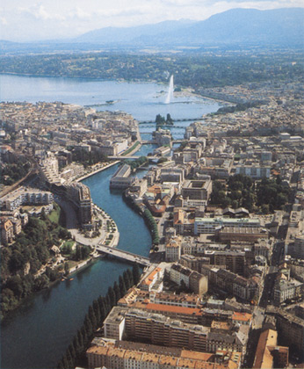
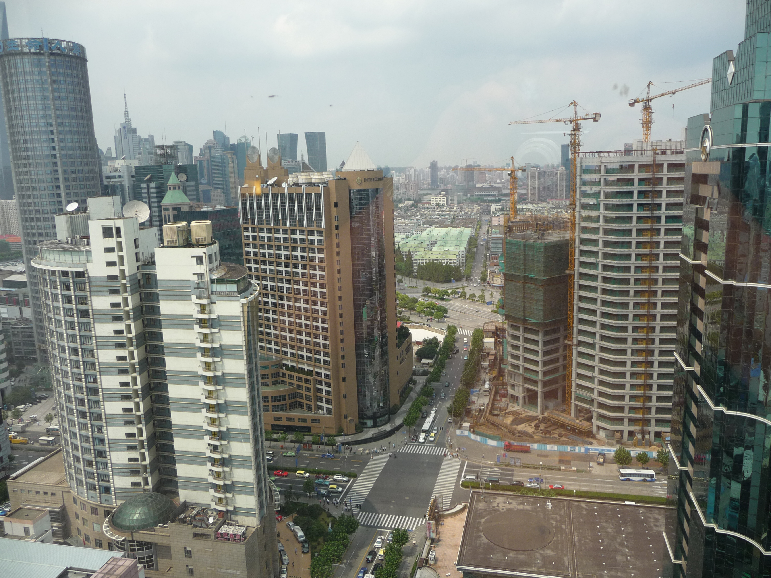
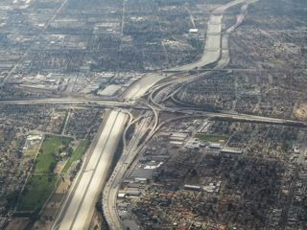
1- Territorialisation of last two centuries of development : Archetypes of built environment in Cities
Small / mid-size cities moderate density
High density big cities
Low density big cities = > sprawl
The needs of the urban population :
Insure the well being of the population–health, education
Provide public services such as transportation, waste management etc.
Mitigate environmental pressures while recognizing its natural assets or limitations
Provide Security (human, infrastructure, environment etc.)
Notes:
How can we better adapt and mitigate

Slide 3
2- WHY CITIES :
Cities are today’s living laboratories that encourage shifts in learning and teaching practices out of the classroom and put real-world challenges into context,
The tools, resources and networks a city has to offer tend to be greatly underutilized within higher education.
While constructivist problem-based learning has increasingly become integrated within higher education with much success, there still remains a gap in teaching students:
How to go from problem identification
To formulation and implementation of innovative and adaptive solutions

Slide 4
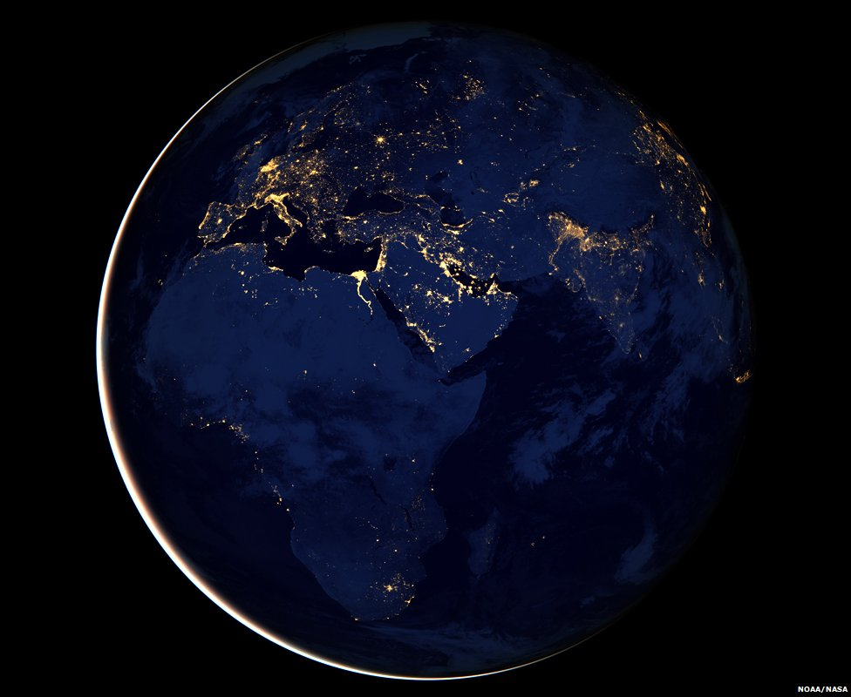
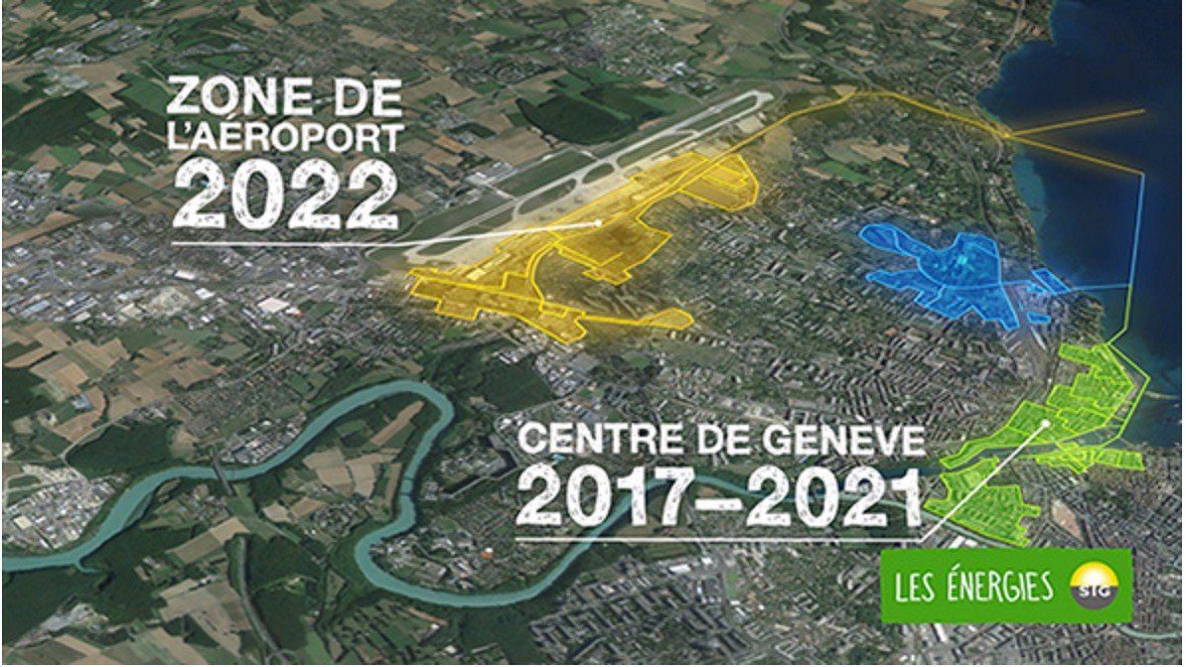
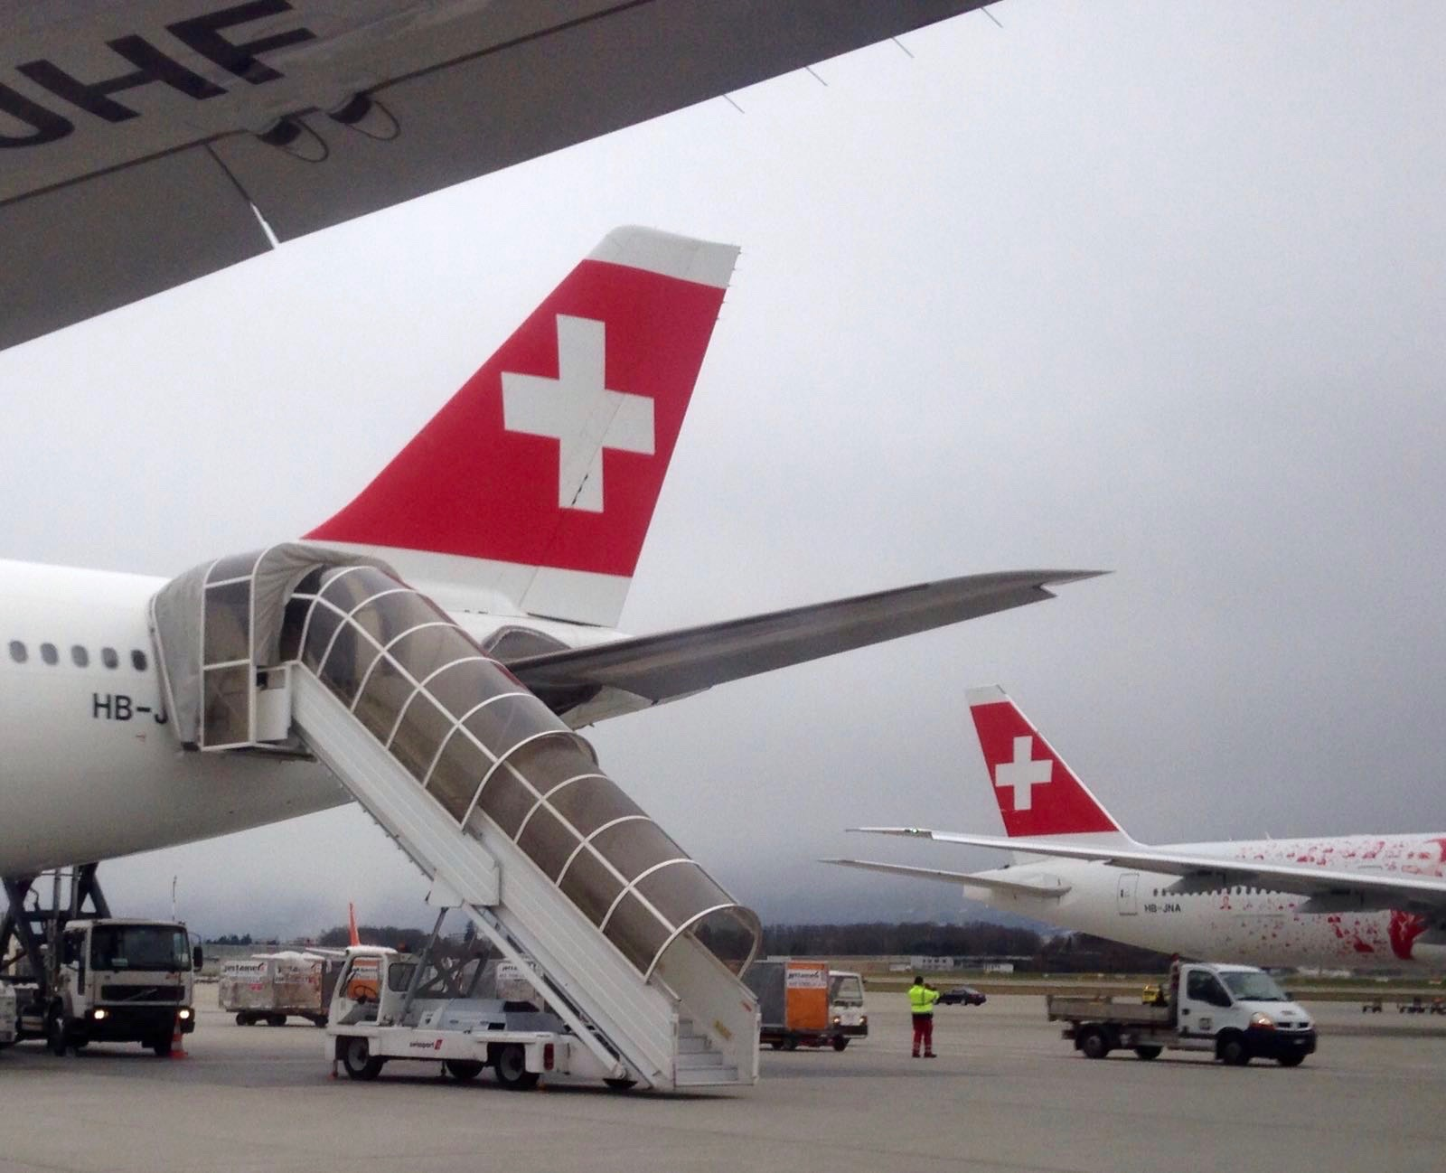
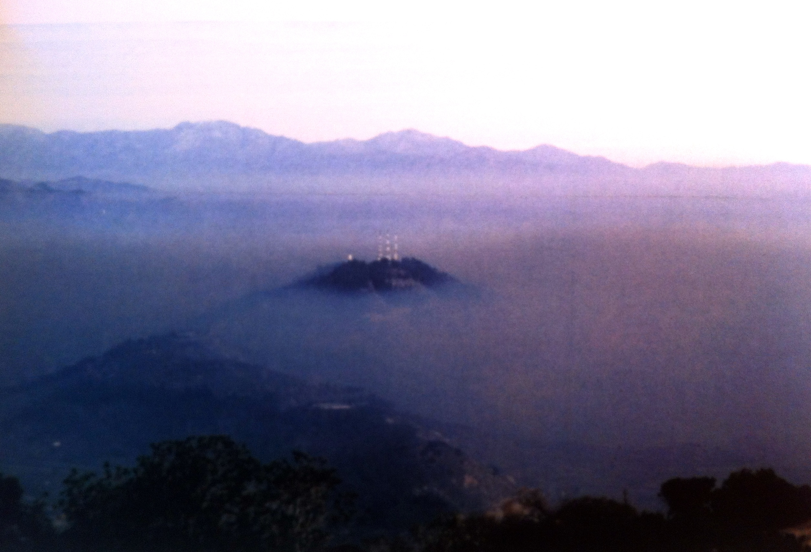
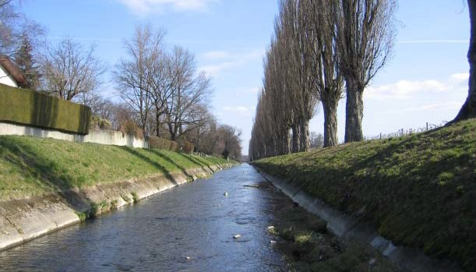
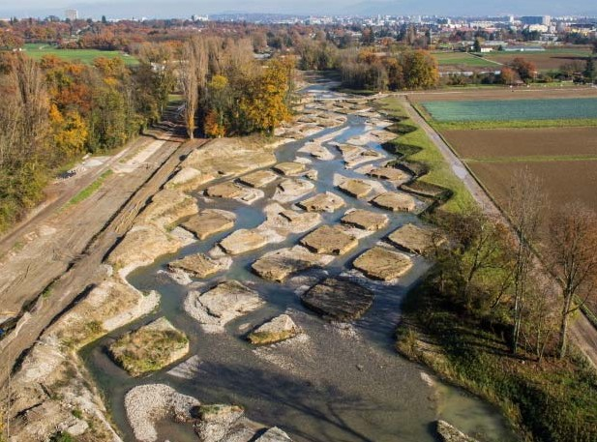
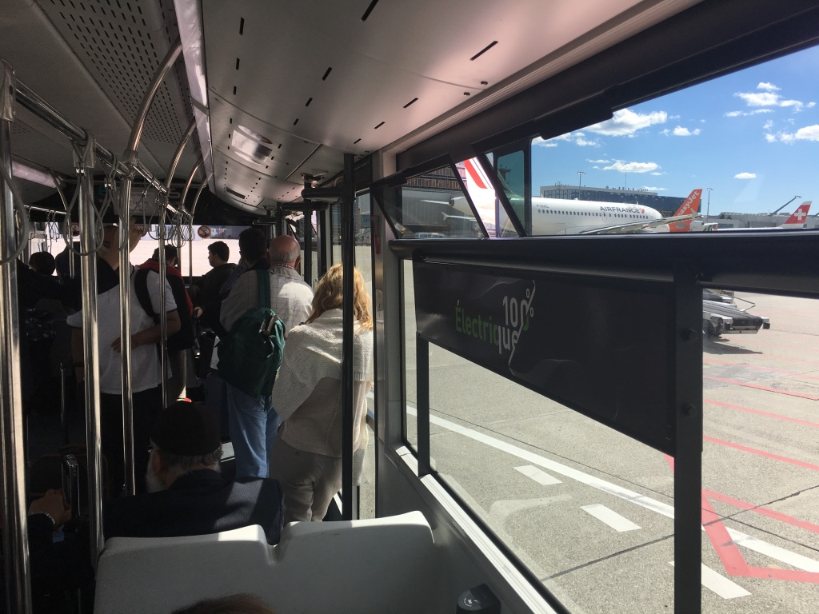
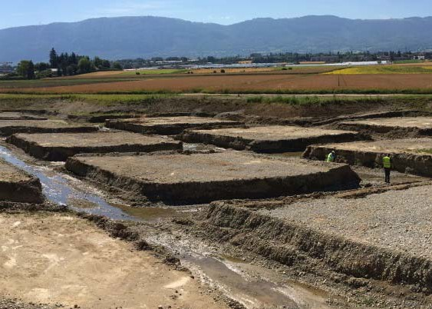
Notes:
Black Marble RenditionVIIRS (Visible Infrared Imaging Radiometer Suite) discerns a range of phenomena of interest to weather forecasters - cloud, snow, fog, etc - even when the satellite is on the dark side of the Earth.
Black marble rendition by showing us the urban area gives us and idea of territorialization of growth across the planet where new regions of growth are emerging
These regions are increaignl interconnected and altering the extablished pattern of economic integration of markets based on a North- North and South- North division

Slide 5
SDG 6: Ensure availability and sustainable management of water and sanitation for all
SDG 7: Ensure access to affordable, reliable, sustainable and modern energy for all
SDG 13: Take urgent action to combat climate change and its impacts
SDG 15: Protect, restore and promote sustainable use of terrestrial ecosystems, sustainably manage forests, combat desertification, and halt and reverse land degradation and halt biodiversity loss
SDG 9: Build resilient infrastructure, promote inclusive and sustainable industrialization and foster innovation
SDG 11: Make cities and human settlements inclusive, safe, resilient and sustainable
Notes:
Black Marble RenditionVIIRS (Visible Infrared Imaging Radiometer Suite) discerns a range of phenomena of interest to weather forecasters - cloud, snow, fog, etc - even when the satellite is on the dark side of the Earth.
Black marble rendition by showing us the urban area gives us and idea of territorialization of growth across the planet where new regions of growth are emerging
These regions are increaignl interconnected and altering the extablished pattern of economic integration of markets based on a North- North and South- North division

Slide 6
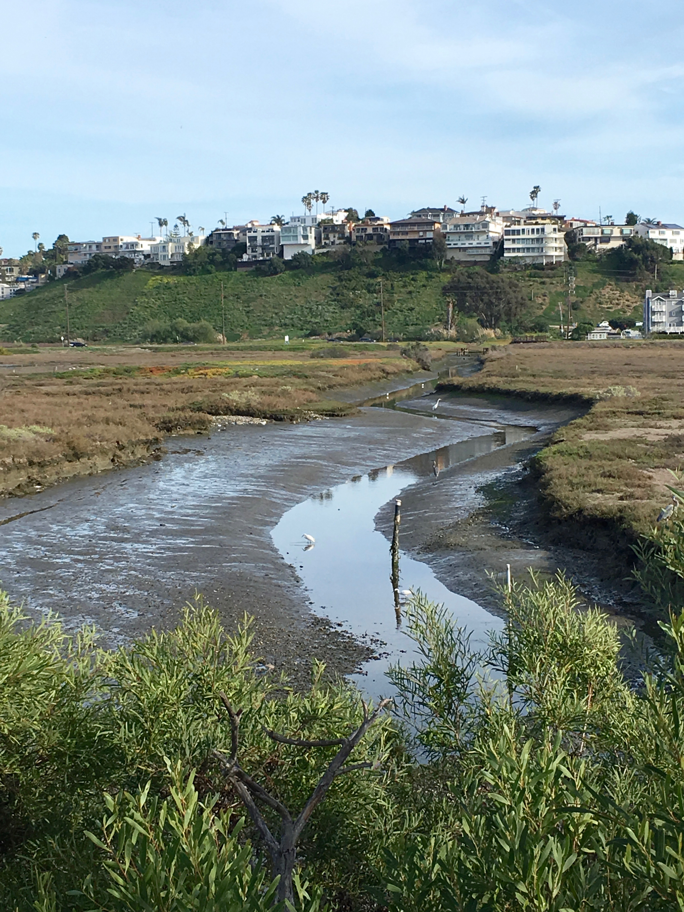
3- SDGs and Cities
Goal 11: Make cities inclusive, safe, resilient and sustainable
Target A : By 2030, reduce the adverse per capita environmental impact of cities, including by paying special attention to air quality and municipal and other waste management
Target B: By 2030, substantially increase the number of cities and human settlements adopting and implementing integrated policies and plans towards inclusion, resource efficiency, mitigation and adaptation to climate change, resilience to disasters, and develop and implement, in line with the Sendai Framework for Disaster Risk Reduction 2015-2030, holistic disaster risk management at all levels

Slide 7
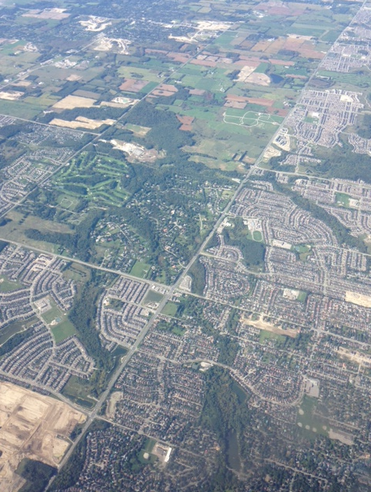
4- How did we get here?
20th Century Cities cities developed in conjuncture with economic cycles. Building booms (Dubai, LA, Mumbai, Shenzhen etc.). Little reflection paid on the wellbeing of their population, quality of public spaces, balance between nature, technology and culture.
…but cities are for living species (Vegetal and animal species ) not only for cars and buildings.
A walkable, compact City ( Copnheagen , Barcelona, Paris ) with public spaces, mixed use is desirable, elegant and enduring.
The goal is to ensure pleasant, human-scale, compact yet comfortable, mixed-use precincts while reducing the many externalities of Carbon based designs (car dependent, waste producer, polluting etc.) while reinforcing its connection with nature.

Slide 8
Global Footprint Network ( 2013): Humanity is now using ecological resources and services at a rate it will take over 1.5 earths to renew:
Japan’s residence use ecological resources of 7.1 Japans
It takes 4 Italys to support Italy
Egypt uses ecological resources of 2.4 Egypts
Cities 80% of Global Economy and 60% Global GHG emissions
Cities are not always practical or efficient as they can be multilayered and multiscaled with multiple intertwined yet not integrated systems.
Mega-trend affecting and shaping cities are shaping our and the planet’s future:
Urban population is increasing and aging
Rise of knowledge economy is shaping the cities
Global middle class is increasing => consumption patterns are threatening hinterlands
Fossil fuel-carbon based design and systems jeopardize quality of life and availability of resources
Mobility is shaping and dominates more and more our lives and urban design ( new role of public spaces
New technologies are integral parts of all private and public spaces
Experts are moving from simplistic linear urban approaches to complex dynamic network systems, system thinking , understanding the importance of integration of systems

Slide 9
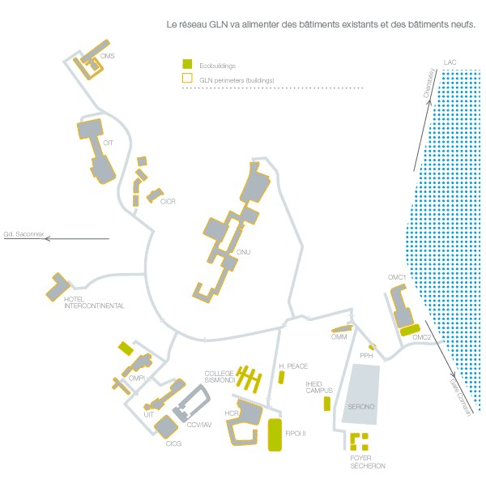
5) Emerging visions and models
A new set of questions and challenges – definition of low carbon, Low waste, ecological and livable city is emerging:
What are the new development approaches needed to transform existing cities
What are the behavioural, technological and urban design options for better managing this change?
What urban form and which scale is best to enable affordable yet ecological mobility?
What models are needed to scale-up good design and practices
The Form of a city plans an important role to emerging models . It is laid out by:
Pattern of streets , boulevards, parklands and building blocks
Network of public spaces
Waterfront or other ecosystem proximity
Reinventing the urban block and streets as a low carbon ecological precinct is emerging as the answer to the many questions as well as the right scale of intervention.
There is no one model fits all the complexity of the local context and culture of living together dictates perimeters of the ideal urban form

Slide 10
6) Ecology, Cities and urban intervention
Open Space Resource Protection
Major creeks, riparian habitat, sloped and other sensitive environmental features should be conserved as open space amenities
Fencing and piping of bodies of water needs to avoided and where it exists retrofitted
Channelization need to be minimized and mimic natural patterns and hydro- dynamics.
Built environment need to play the dual functions of its first and secondary purpose ( bicycle paths for mobility but also open access to ecosystems)
Natural features and sensitive habitats need to be brought back to the block or the street
Low density big cities = > sprawl
Notes:
How can we better adapt and mitigate

Slide 11
Drainage and wetlands
Existing drainage ways and wetlands should be maintained or enhanced
Open spaces should be used to enhance the natural dynamics of drainage of rain water and filtering to aquifer avoiding impermeable constriction materials and coverings.
All rain run-offs must be treated on site with biological retention and filtration.
The Urban Block and street design need to enable the natural filtration processes
Indiginous landscaping species need to be used to foster adaptation cpacity to CC
Green spaces need to play a new role of heath island alelviation
The next american metropolis,
Peter Calthrope 1993
Notes:
How can we better adapt and mitigate

Slide 12
Energy conservation
Energy conservation should be a main goal of retrofitting projects for blocks and streets.
The main aim is individual buildings ( residential , business, office building etc.
Strategies such PVC / solar panel covering of rooftops, facades and balconies need to be used
Natural ventilation , daylighting and biomass shading should be used extensively to restore natural cooling and heating dynamics and processes.
Mico-climate effect can be enhanced through intelligent building configurations and landscape treatments.
Features such as porches, courtyards and overhangs can be added to the buildings to creat buffer zones
Narrower streets will reduce the energy use and loss and encourage soft mobility
Low density big cities = > sprawl
The next american metropolis,
Peter Calthrope 1993
Notes:
How can we better adapt and mitigate

